Slide 1
Chapter 9
Subprograms

Slide 2
Fundamentals of Subprograms
Two fundamental abstraction facilities can be included in a programming language:
process abstraction => subprograms
data abstraction => class

Slide 3
Fundamentals of Subprograms
A subprogram is
a collections of statements
or a program
called by the main program or another program
to perform a particular task
or function
for the program

Slide 4
Fundamentals of Subprograms
Collections of statements
Could be performed multiple times
Reusable
Reuse is also an abstraction
Saving memory space and coding time
Emphasizing its logical structure while hiding the low-level details

Slide 5
Fundamentals of Subprograms
General Subprogram Characteristics
Each subprogram has a single entry point
The calling program is suspended during execution of the called subprogram
Control always returns to the caller when the called subprogram’s execution terminates

Slide 6
Subprograms in Python
The difference than other common programming languages is that function def statements are executable.
When a def statement is executed, it assigns the given name to the given function body.
Until a function’s def has been executed, the function cannot be called.

Slide 7
Subprograms in Python
The subprogram header;
def functionname( parameters ): function_suite
return [expression]
The subprogram call;
functionname( parameters )

Slide 8
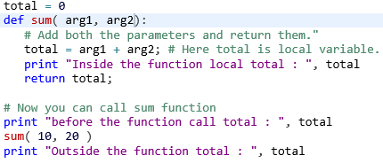

Subprograms in Python

Slide 9
Subprograms/Functions in C++
Prototype
return_type function_name( type parameter)
Call
function_name(parameter);
header
return_type function_name( type parameter)
{ body of the function }

Slide 10
Subprograms in C++
#include <iostream>
void fun1(void); /* prototype */
int main ()
{ fun1(); /* call */
system("pause");
}
void fun1(void) /* header */
{ int b=4; cout<<" b="<<b;} /* definition */

Slide 11
Subprograms in C++
#include <iostream>
int fun1(int x); /* prototype */
using namespace std;
int main ()
{ int a=1; cout<<"\n main1 a="<<a;
cout<<"\n function result : " <<fun1(5) <<a="<<a;
system("pause"); }
int fun1(int x) { int a; cout<< " x="<< x;
a = x + 3; return a; }

Slide 12
Subprograms/Functions in JavaScript
Call
function_name (parameter)
header
Function function_name( parameter)
{ body of the function }

Slide 14
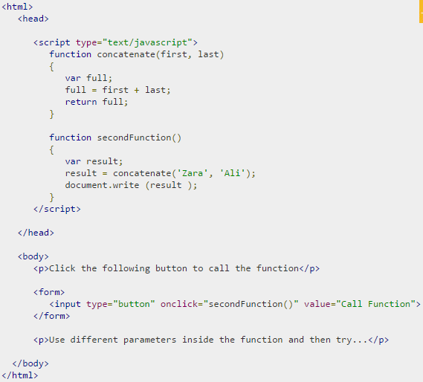

Slide 15
Basic Definitions
Main program
subprogram declarations
…………
subprogram call (actual parameters)
………………
subprogram header (formal parameters)
subprogram definition

Slide 16
Basic Definitions
A subprogram definition describes the interface to and the actions of the subprogram abstraction
A subprogram call is an explicit request that the subprogram be executed
A subprogram header is the first part of the definition, including the name, the kind of subprogram, and the formal parameters
The parameter profile (aka signature) of a subprogram is the number, order, and types of its parameters
The protocol is a subprogram’s parameter profile and, if it is a function, its return type

Slide 17
Basic Definitions subprogram declaration
A subprogram declaration provides the protocol, subprograms be defined before they are called.
In most other languages (other than C and C++), subprograms do not need declarations
Function declarations in C and C++ are often called prototypes
void fun1(void);

Slide 18
Basic Definitions; A subprogram header
Python def sum( arg1, arg2 ):
JavaScript function sum(arg1, arg2)
C/C++ void sum(arg1, arg2)
arg1 and arg2 are formal parameters

Slide 19
Basic Definitions; A subprogram body
C-based languages (and some others like JavaScript) the body of a subprogram is delimited by braces { .. }
The statements in the body of a Python function must be indented and the end of the body is indicated by the first statement that is not indented
In Ruby, an end statement terminates the body of a subprogram

Slide 20
Parameters
two ways that a subprogram can gain access to the data that it is to process:
through direct access to nonlocal variables (declared elsewhere but visible in the subprogram)
or through parameter passing

Slide 21
Parameters; nonlocal variables
Extensive access to nonlocals can reduce reliability
assign new values to those nonlocal variables between calls to the subprogram

Slide 22
Parameters; parameter passing
accessed through names that are local to the subprogram
Parameter passing is more flexible than direct access to nonlocal variables
the types of the parameters should be competible

Slide 23
Parameters
Main program
…………
subprogram call (actual parameters)
……………… positional or keyword
subprogram header (formal parameters)

Slide 24
Parameters
The passing parameters have certain restrictions as
Same number of parameters in both sides (except the default values for formal parameters,)
in the same order,
Have the same data type
May have different names

Slide 25
Parameters; formal parameter
A formal parameter is a variable listed in the subprogram header and used in the subprogram
They are not variables in the usual sense
In most cases, they are bound to storage only when the subprogram is called
The binding is often through some other program variables

Slide 26
Parameters; actual parameter
Subprogram call statements must include the name of the subprogram and a list of parameters to be bound to the formal parameters of the subprogram.
These parameters are called actual parameters

Slide 27
Parameters; positional parameter
In nearly all programming languages, the binding of actual parameters to formal parameters is done by position
The first actual parameter is bound to the first formal parameter and so forth.
Such parameters are called positional
parameters.
This is an effective and safe method as long as the parameter lists are relatively short.

Slide 28
Parameters; keyword parameter
When lists are long, one solution to this problem is to provide keyword parameters
The formal parameter is bounded with the actual parameter in a call
The advantage of keyword parameters is that they can appear in any order in the actual parameter list
C++ dosnt support

Slide 29
Parameters; keyword parameter
Python functions can be called using this technique, as in
sumer(length = my_length, list = my_array,
sum = my_sum)
where the definition of the functions
def sumer(length, list, sum):

Slide 30
Parameters; keyword parameter
In Python, keyword and positional parameters can be mixed in a call, as in
sumer (my_length, sum = my_sum, list = my_array)
The only restriction with this approach is that the keyword parameters should be after positional parameters

Slide 31
Actual/Formal Parameter Correspondence
Positional
Advantage: Safe and effective
Disadvantage: If the parameter lists are long, it is easy for a programmer to make mistakes in the order of actual parameters in the list
Keyword
Advantage: Parameters can appear in any order, thereby avoiding parameter correspondence errors
Disadvantage: User must know the formal parameter’s names

Slide 32
Formal Parameter Default Values
In certain languages (e.g., C++, Python, Ruby, PHP), formal parameters can have default values, if no actual parameter is passed.
In Python
def sum( arg1, arg2, arg3=4 ):
sum( 10, 20 );

Slide 33
Formal Parameter Default Values
In C++, default parameters must appear last because parameters are positionally associated
float compute_pay(float income, float tax_rate, int exemptions = 1)
pay = compute_pay(20000.0, 0.15);

Slide 34
Procedures and Functions
There are two categories of subprograms
Procedures are collection of statements that define parameterized computations
Do not return values
Fortran and Ada support procedures
Functions structurally resemble procedures but are semantically modeled on mathematical functions
return values

Slide 35
Local Referencing Environments
Variables that are defined inside subprograms are called local variables, their scope is usually the body of the subprogram
Local variables can be stack-dynamic. They are bound to storage when the subprogram begins execution and are unbound from storage when that execution terminates.
- Advantages
Support for recursion
Storage for locals is shared among some subprograms
Disadvantages
Allocation/de-allocation, initialization time
Indirect addressing
Subprograms cannot retain data values of local variables between calls.

Slide 36
Local Referencing Environments
Local variables can be static
Advantages:
no run-time overhead for allocation and deallocation
The data values of local variables between calls, can be retained
Disadvantages:
inability to support recursion

Slide 37
Local Referencing Environments: Examples
In most contemporary languages, locals are stack dynamic
In C-based languages, locals are by default stack dynamic, but can be declared static
int adder(int list[], int listlen) {
static int sum = 0;
int count;
for (count = 0; count < listlen; count ++)
sum += list [count];
return sum; }

Slide 38
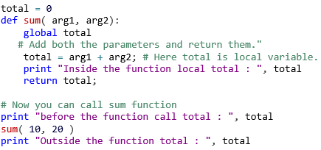
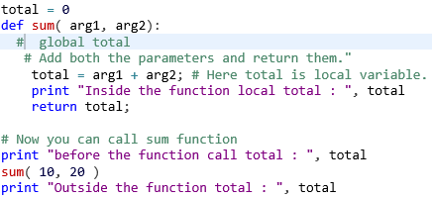


Local Referencing Environments: Examples
In Python it can be declared global for static variables

Slide 39
Nested Subprograms
If a subprogram is needed only within another subprogram, it might be placed there and hide it from the rest of the program
Many languages, including the C-based ones do not allow subprogram nesting
Some new languages JavaScript,
Python, Ruby, Lua and most functional programming languages allow subprograms to be nested.

Slide 40
Semantic Models of Parameter Passing
In mode; the parameter is transfered to the subprogram and it is not to be changed by the subprogram
Out mode; there is no initial value for the parameter and its computed value must be returned to the caller
Inout mode; the subprogram needs the given value of the parameter and must return its new value

Slide 41
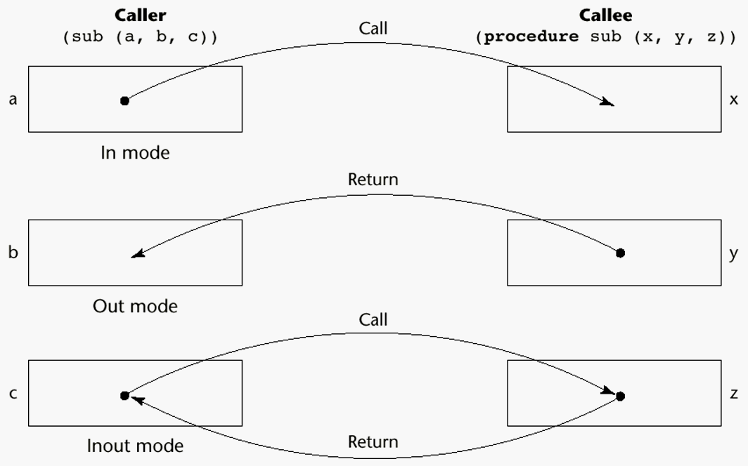
Models of Parameter Passing

Slide 42
Conceptual Models of Transfer
There are two conceptual models of how data transfers take place in parameter transmission;
An actual value is copied (to the caller, to the called, or both ways)
An access path (a simple pointer or reference) is transmitted

Slide 43
Pass-by-Value (In Mode)
The value of the actual parameter is used to initialize the corresponding formal parameter
Normally implemented by copying
Can be implemented by transmitting an access path but not recommended (enforcing write protection is not easy)
Disadvantages (if by physical move): additional storage is required (stored twice) and the actual move can be costly (for large parameters)
Disadvantages (if by access path method): must write-protect in the called subprogram and accesses cost more (indirect addressing)

Slide 44
Pass-by-Result (Out Mode)
When a parameter is passed by result, no value is transmitted to the subprogram; the corresponding formal parameter acts as a local variable; its value is transmitted to caller’s actual parameter when control is returned to the caller, by physical move
Require extra storage location and copy operation
Potential problems:
sub(p1, p1); whichever formal parameter is copied back will represent the current value of p1
sub(list[sub], sub); Compute address of list[sub] at the beginning of the subprogram or end?

Slide 45
Pass-by-Value-Result (inout Mode)
A combination of pass-by-value and pass-by-result
Sometimes called pass-by-copy
Formal parameters have local storage
Disadvantages:
Those of pass-by-result
Those of pass-by-value

Slide 46
Pass-by-Reference (Inout Mode)
Pass an access path
Also called pass-by-sharing
Advantage: Passing process is efficient (no copying and no duplicated storage)
Disadvantages
Slower accesses (compared to pass-by-value) to formal parameters
Potentials for unwanted side effects (collisions)
Unwanted aliases (access broadened)
fun(total, total); fun(list[i], list[j]; fun(list[i], i);

Slide 47
Arrays as Parameters
#include <iostream>
int * fun1(int * ); /* prototype */
using namespace std;
int main ()
{ int a [5] = {1,2,3,4,5}; int *ptr; ptr = a;
cout<<“main prg array a ptr="<<ptr<<" *ptr="<< *ptr;
cout<<"\n function result : " <<fun1(ptr)<<"\n";
system("pause"); }
int * fun1(int * p) { int a [5], *ptr; ptr=a;
cout<<"\nfun1 parameter p="<<p<<“array a ptr="<< ptr;
for (int i=0;i<5;i++) { *ptr = *p+4;
cout<<"\n*p=" <<*p<<“*ptr=“<<*ptr<<“a[i]=“<<a[i] ;
ptr++; p++;} return ptr-5; }

Slide 48

Arrays as Parameters

Slide 49
Multidimensional Arrays as Parameters
If a multidimensional array is passed to a subprogram and the subprogram is separately compiled, the compiler needs to know the declared size of that array to build the storage mapping function

Slide 50
Multidimensional Arrays as Parameters: C and C++
Programmer is required to include the declared sizes of all but the first subscript in the actual parameter
Disallows writing flexible subprograms
Solution: pass a pointer to the array and the sizes of the dimensions as other parameters; the user must include the storage mapping function in terms of the size parameters

Slide 51
Multidimensional Arrays as Parameters: Fortran
Formal parameters that are arrays have a declaration after the header
For single-dimension arrays, the subscript is irrelevant
For multidimensional arrays, the sizes are sent as parameters and used in the declaration of the formal parameter, so those variables are used in the storage mapping function

Slide 52
Multidimensional Arrays as Parameters: Java and C#
Similar to Ada
Arrays are objects; they are all single-dimensioned, but the elements can be arrays
Each array inherits a named constant (length in Java, Length in C#) that is set to the length of the array when the array object is created

Slide 53
Design Considerations for Parameter Passing
Two important considerations
Efficiency
One-way or two-way data transfer
But the above considerations are in conflict
Good programming suggest limited access to variables, which means one-way whenever possible
But pass-by-reference is more efficient to pass structures of significant size

Slide 54
Design Issues for Functions
Are side effects allowed?
Parameters should always be in-mode to reduce side effect (like Ada)
What types of return values are allowed?
Most imperative languages restrict the return types
C allows any type except arrays and functions
C++ is like C but also allows user-defined types
Ada subprograms can return any type (but Ada subprograms are not types, so they cannot be returned)
Java and C# methods can return any type (but because methods are not types, they cannot be returned)
Python and Ruby treat methods as first-class objects, so they can be returned, as well as any other class
Lua allows functions to return multiple values

